Slide 1
Linux File System

Slide 2
AGENDA
What is a Linux File system?
Types of Linux File System (Logical FS and Physical FS)
File System Architecture
File System Directories
Features of Linux File Systems

Slide 3
What is Linux File System?
A Linux file system is a structured collection of files on a disk drive or a partition.
A partition is a segment of memory and it contains some specific data.
A file system is a set of processes that controls on how, where and what data is stored and retrieved from a storage devices.

Slide 4
Types of Linux File Systems
A standard Linux Distribution provides the choice of partitioning disk with the file formats listed below, each of which has special meaning associated with it.
ext2
ext3
ext4
Jfs
XFS
ReiserFS
Btrfs

Slide 5
ext2, ext3, ext4
These are the progressive version of Extended Filesystem (ext), which primarily was developed for MINIX.
The second extended version (ext2) was an improved version.
Ext3 added performance improvement.
Ext4 was a performance improvement besides providing additional features.

Slide 6
JFS
The Journaled File System (JFS) was developed by IBM for AIX UNIX which was used as an alternative to file system ext.
JFS is an alternative to ext4 currently and is used where stability is required with the use of very few resources.
When CPU power is limited JFS comes handy.
XFS
XFS was a high speed JFS which aimed at parallel I/O processing.
NASA still usages this file system on their 300+ terabyte storage server.

Slide 7
ReiserFS
It was introduced as an alternative to ext3 with improved performance and advanced features.
ReiserFS supports File System Extension dynamically which was relatively an advanced feature but the file system lacked certain area of performance.
Btrfs
B-Tree File System (Btrfs) focus on fault tolerance, fun administration, repair System, large storage configuration.
Btrfs is not recommended for Production System.

Slide 8
Types of Files in Linux
In Linux, file is defined as simply the thing that deals with a sequence of bytes
Hence, everything is file in Linux:
An ordinary file is a file; a directory is also file; a network card, a hard disk, any device are also files since they deal with a sequence of bytes
Linux Supports Five Types of files
Simple/Ordinary files (text file, c++ file, etc)
Directory files
Link files (Symbolic (soft))
Block or Character Special files
Socket files
Named pipe (FIFO) files

Slide 9
Linux Types of Files
Regular or ordinary files
Regular or ordinary files store data of various content types such as text, audio, video, images, scripts, and programs. There are hundreds of content types. In Linux, regular files can be created with or without an extension.
An extension is a group of characters that is used with the file name to give it a special identity or to group it with files of the similar content type. For easy recognition and processing, files of different content types often use well-known file extensions.
Although the Linux file system does not need file extensions, still you should use them. They help us in identifying the types of content that are stored in files.
You can see file extensions supported by Linux in the /etc/mime.types file
Directory files
To organize files in a hierarchy, file systems use directories. Directories are also files, but instead of storing data, they store the location of other files. To store the location of files placed in the directory, the directory uses directory entries. Each directory entry stores the name and location of a single file.
Linux file system starts with a directory called / or root directory. All files and directory files are created under this directory. Except the root directory, each directory has a parent directory.

Slide 10
Linux Types of Files
Symbolic (soft) link file
Not a real file, just a link to another file
Allow giving another name to a file without actually duplicates it hence save memory space
Ref: https://www.geeksforgeeks.org/soft-hard-links-unixlinux/
Special file (device)
Each hardware device, e.g. keyboard, hard disk, CD-ROM, etc is associated with at least one file
Usually store in /dev directory
Applications can read and write any devices by reading and writing their associate file – hence the access method is known as device independent
Special files divided into two types:
character special files, e.g. keyboard, and
block special files, e.g. disk

Slide 11
Linux Types of Files
Socket files
A socket is a communication endpoint that applications use to exchange data.
For example, if an application wants to communicate with another application, it connects with the socket of that application.
Socket files are the special files that use a file name as their address instead of an IP address and port number.
Socket files use the sendmsg() and recvmsg() system calls to enable inter-process communication between local applications.
Named pipe files
Linux allows us to send the output of any process or command to another process or command as the input. This feature is known as the pipe.
Pipes work only when both processes are started by the same user and exist in the same parent process space.
If processes are executed under different user names and permissions, then standard pipes do not work.
In such circumstances, named pipes are used.
Named pipes are similar to the standard pipes except that they can be accessed as part of the filesystem.

Slide 12
The following table lists the symbol of different types of files.
Character | Meaning
- | Regular or ordinary file
d | Directory file
l | Link file
b | Block special file
p | Named pipe file
c | Character special file
s | Socket file

Slide 13
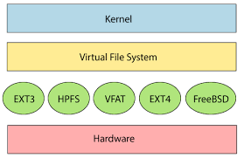
File System Architecture
Commands to check supported file systems in Linux: cat /proc/filesystems

Slide 14
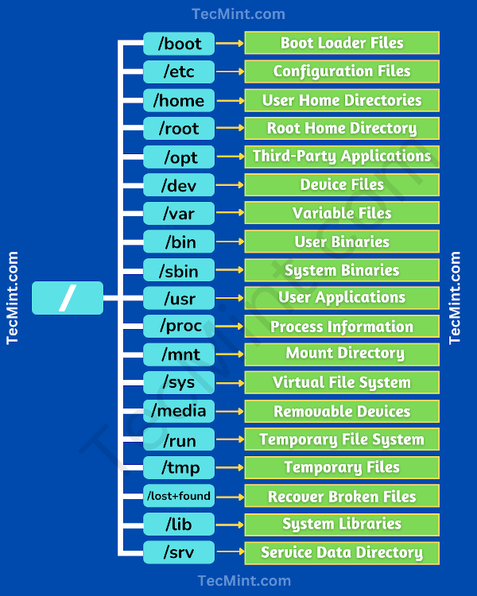
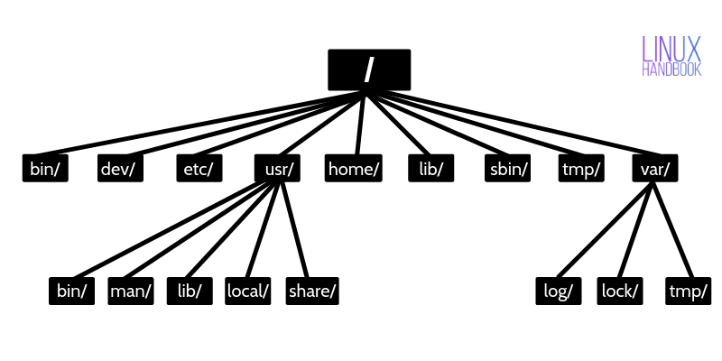
File System Directories

Slide 15
File System Structure
According to the File System Standard (FSSTND) proposed in 1994, every LINUX system should contain a set of standard files and directories
Root Directory ( / )
Top of the file system. Similar to C:\ in DOS
/bin
Contains the binary (executable code) of most essential Linux command, e.g. bash, cat, cp, ln, ls, etc.
/boot
Contain all the files needed to boot the Linux system, including the binary of the Linux kernel.
E.g., on Red Hat Linux 6.1, the kernel is in /boot/vmlinux-2.2.5-15 file

Slide 16
File System Structure
/dev
Contains the special files for devices, e.g. fd0, hd0, etc.
/etc
Contains host-specific files and directories,
e.g. information about system configuration
/etc/passwd
This file contains login information of users in the system
/home
Contains the home directories of every user in the system
/lib
Stores all the essential libraries for different language compilers

Slide 17
File System Structure
/mnt
Used by system administrator to mount file systems temporarily by using the mount command
Before using any devices, they have to be mounted to the system for registration
/opt
Used for installing add-on software packages, e.g. star office, etc.
/proc
Contain process and system information
/root
Home directory of the user root, usually the administrator
/sbin
The directories /sbin, /usr/sbin, and /usr/local/sbin contain system administration tools, utilities and general root only commands, such as halt, reboot and shutdown

Slide 18
File System Structure
/tmp or /temp
Contains temporary files. Usually files in this directory will be deleted from time to time to avoid the system fills with temp files
/usr
One of the largest sections of the Linux file system
Contains read-only data that are shared between various users
e.g. the manual pages needed for the command man stored in /usr/man directory
/var
Contain data that keeps on changing as the system is running.
E.g. /var/spool/mail directory keeps the mail of user

Slide 19
Linux File System Features
Specifying paths: Linux does not use the backslash (\) to separate the components; it uses forward slash (/) as an alternative.
Partition, Directories, and Drives: Linux does not use drive letters to organize the drive as Windows does. In Linux, we cannot tell whether we are addressing a partition, a network device, or an "ordinary" directory and a Drive.
Case Sensitivity: Linux file system is case sensitive. It distinguishes between lowercase and uppercase file names. Such as, there is a difference between test.txt and Test.txt in Linux.
File Extensions: In Linux, a file may have the extension '.txt,' but it is not necessary that a file should have a file extension.
Hidden files: Linux distinguishes between standard files and hidden files, mostly the configuration files are hidden in Linux OS. Usually, we don't need to access or read the hidden files. The hidden files in Linux are represented by a dot (.) before the file name

Slide 20
Thanks

